Slide 1
Computational Quantum Mechanics
Prof. Gerson J. Ferreira
INFIS/UFU 2020/1
Using Jupyter Notebooks and Markdown
https://gitlab.com/gersonjferreira/computational-quantum-mechanics

Slide 2
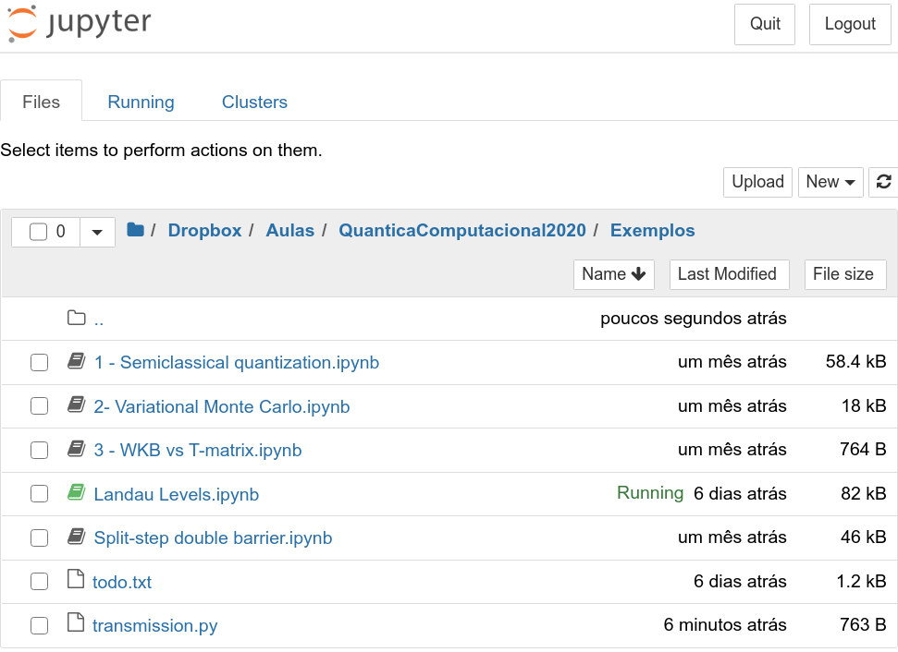
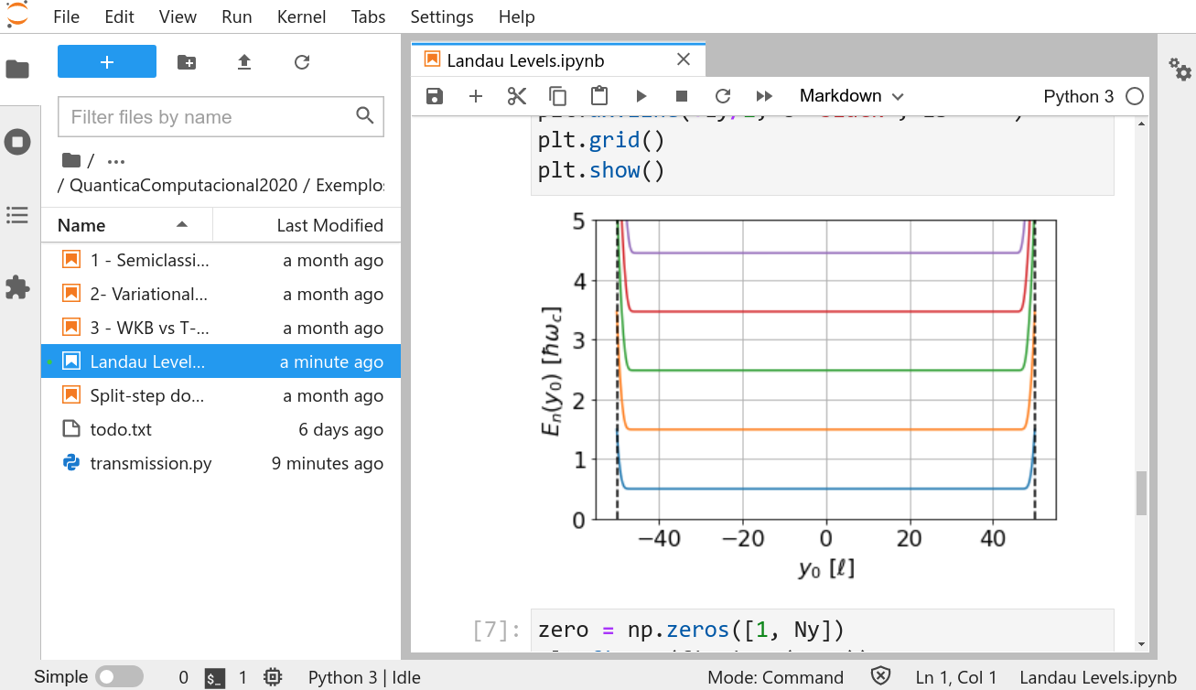
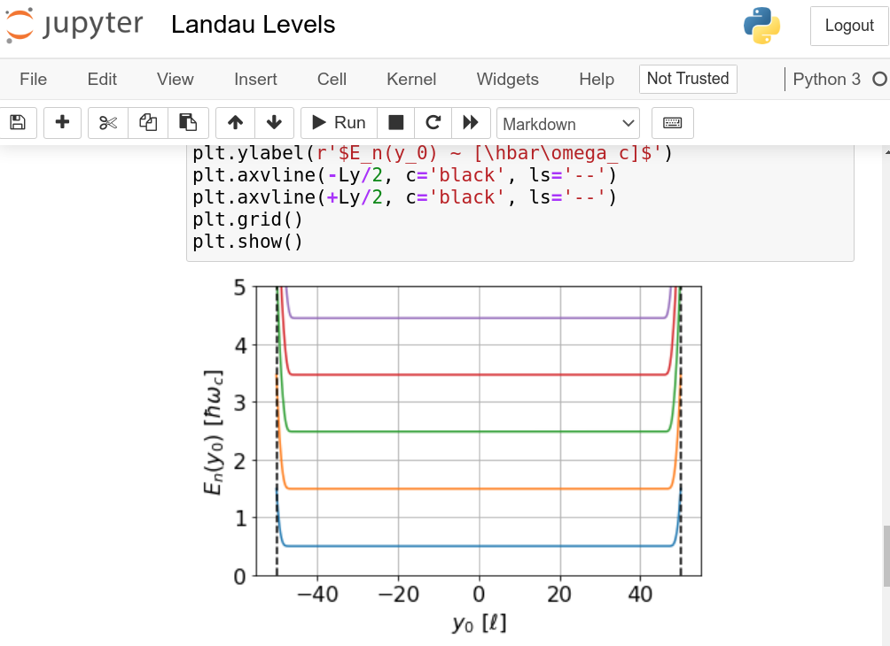
Python with Jupyter Notebooks + Markdown
Jupyter Notebook vs JupyterLab
→ Jupyter Notebook: one document on each browser tab
→ JupyterLab: single tab, multiple documents within sub-tabs
Also: JupyterLab has better visualization for CSV files, allows for plugins, etc...

Slide 3
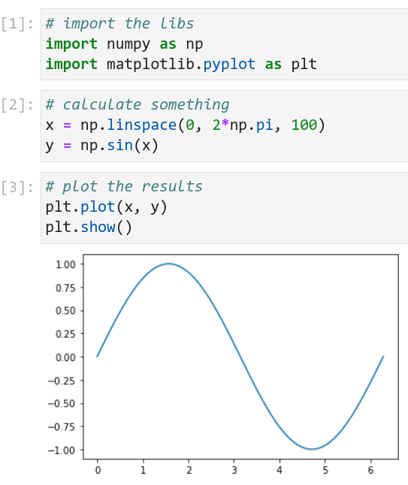

Jupyter: writing and running codes
Organize the code in cells by its content
→ import all neeeded libs in single cell
→ run blocks of calculations
→ plot the results
To run each cell: SHIFT+ENTER
Add a cell below
Restart and re-run all
Restart
Stop the calculation!
To delete a cell:
→ While coding on it: ESC + D + D, or
→ Click its number to select and: D + D

Slide 4
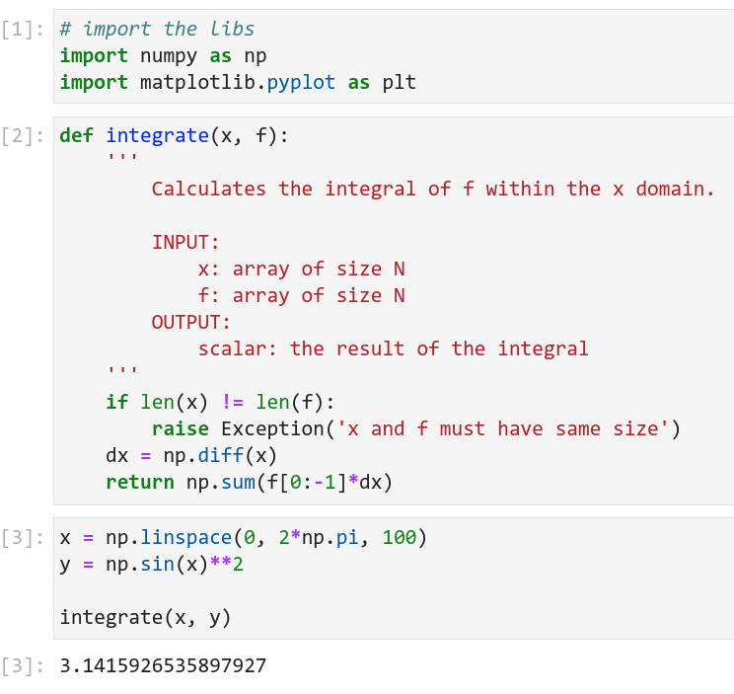
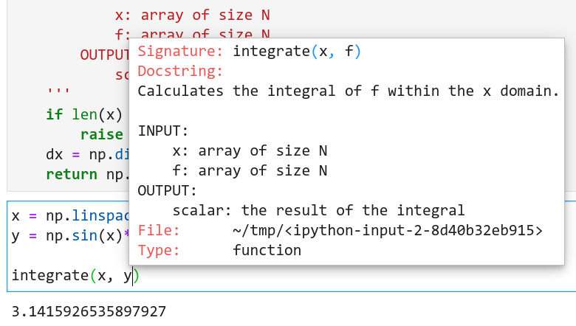
Jupyter: autocomplete and docstrings
Organization:
→Use a cell to define each function
→Use docstrings to describe the function,
and its input & output quantities
Autocomplete: press TAB
Show docstring: press SHIFT+TAB
with the cursor within the function call

Slide 5
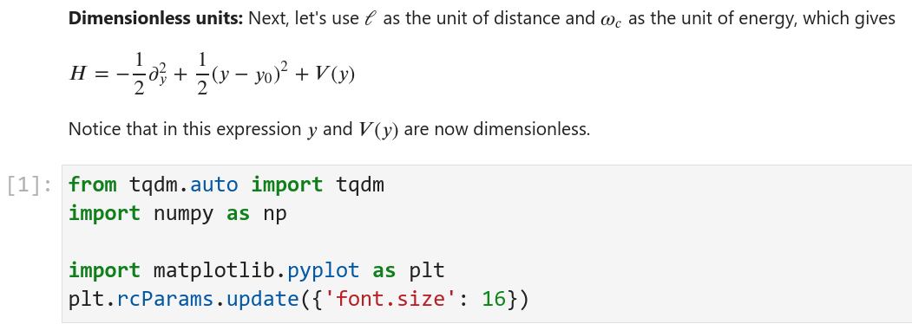
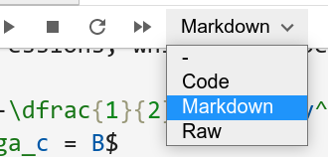
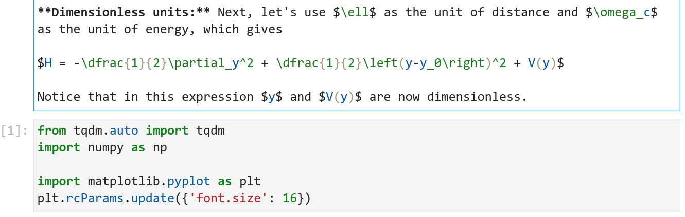
Markdown + Latex
Let’s use Markdown to document the math and physics behind the codes
SHIFT+ENTER to render it
DOUBLE CLICK to edit it

Slide 6
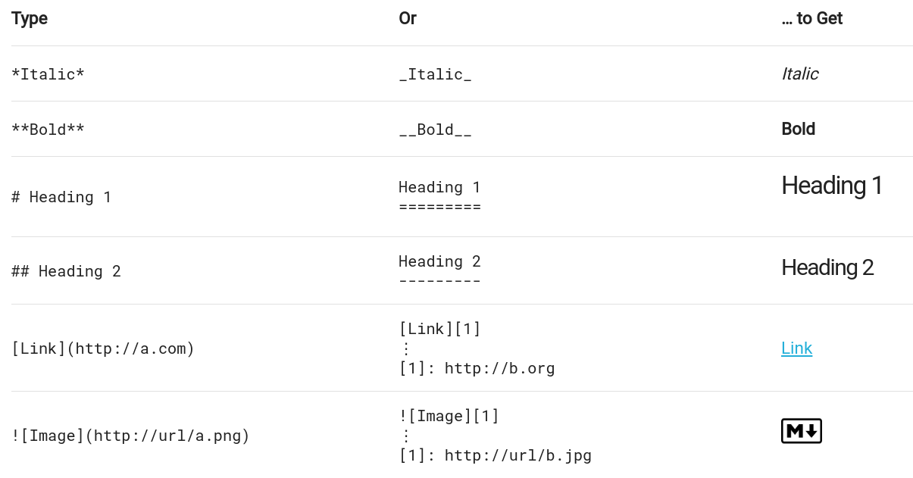
Markdown examples
Check these links: [https://commonmark.org/help/] [https://www.markdownguide.org/cheat-sheet/]

Slide 7
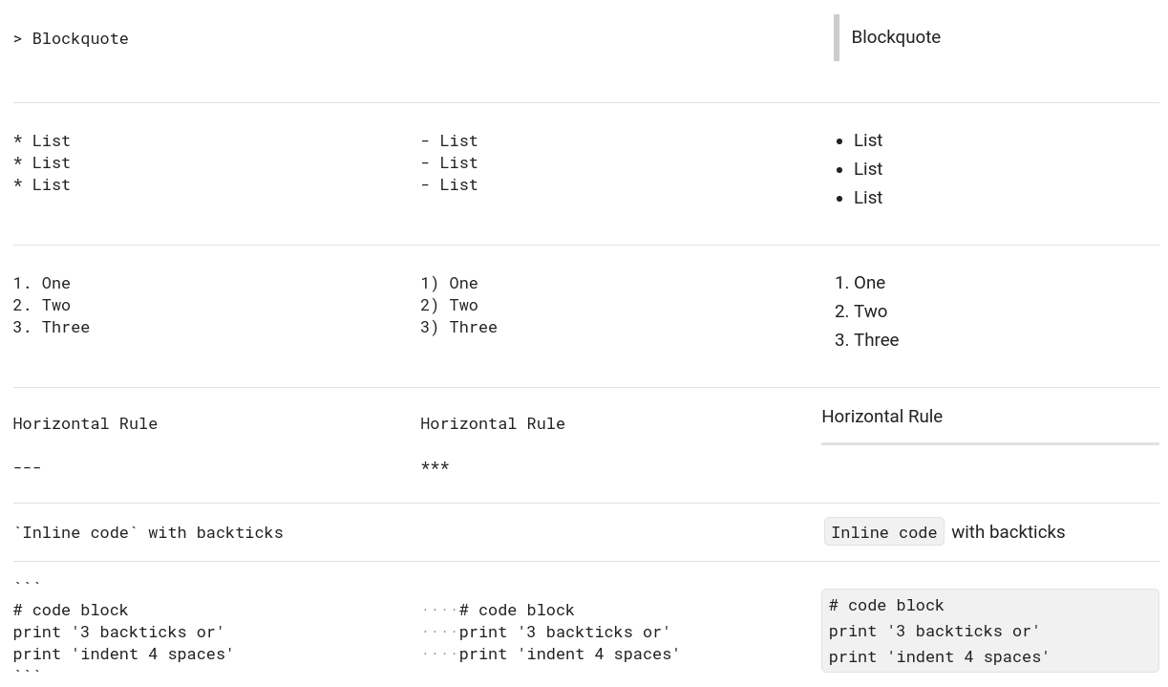
Markdown examples

